Slide 1

Adaptive Traffic Signal Control Expert System: Improving traffic flow using intelligent decision-making
By Group 21 – ThinkBot Circle

Slide 2
Our Idea
Content:
Develop an Expert System to control traffic lights intelligently
Focus on University of Ghana, Accra traffic conditions
System adapts based on:
Traffic density
Weather conditions
Time of day
Pedestrians, etc.
Key Goal: The system uses rule-based decision making to -
Reduce congestion
Improve road safety

Slide 3
Knowledge Acquisition
“How would a human traffic officer think?”
Research:
Ghana Highway Code manual (road markings, signs, etc.)
Motor Traffic & Transport Department website guidelines
National Road Safety Authority recommendations
Real-life traffic problems in Accra reported on news websites
Monitored expert reasoning (traffic officer decisions around the University roads)

Slide 4
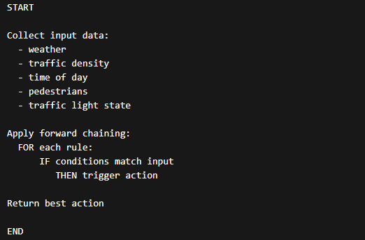
A summary of our System Logic (Pseudocode)

Slide 5
Our Main code in operation from the controller
Our modular design makes the system easy to maintain and extend. The results comes from when the Expert System:
Collects inputs
Sends to Prolog
Prolog then: - Matches rules - Resolves conflicts - Returns actions
Python Prints the results

Slide 6
Final Thoughts (System Features & Strengths)
What we’ve covered:
Real-time adaptive decisions
Safety-focused (pedestrians + weather)
Scalable (more rules can be added)
All using AI concept of Expert Systems and Knowledge Base Systems

Slide 7
End Credits of ThinkBot Circle Team Members
Nana Adwoa Aforo Osei [Project Manager] Bilson Priscilla Essirifua [Knowledge Engineer] Adu Selina Odoi [Knowledge Engineer] Adwoa Pokua [Programmer] Aryee Emerald [Programmer] Elliot Elorm Nutsuakor [Programmer] Stephen Edem Kwame Doe-lawson [Programmer]

